Slide 1
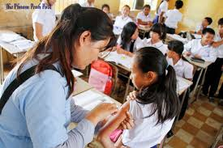
88th NGOs and Community Membership Meeting
23 Jun 2023
HPV Nationwide Scale up in 2023
and HPV Multi-Age Cohort Campaign in 2024
Mr. Ork Vichit, MPH
Manager of National Immunization Program
Deputy Director of National Maternal and Child Health Center

Slide 2
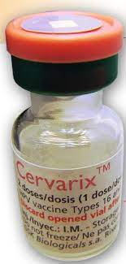
Outlines
Target population for HPV routine and Multi-Age Cohort Campaign
HPV vaccination schedule
HPV vaccination strategy
Strengths and Challenges

Slide 3
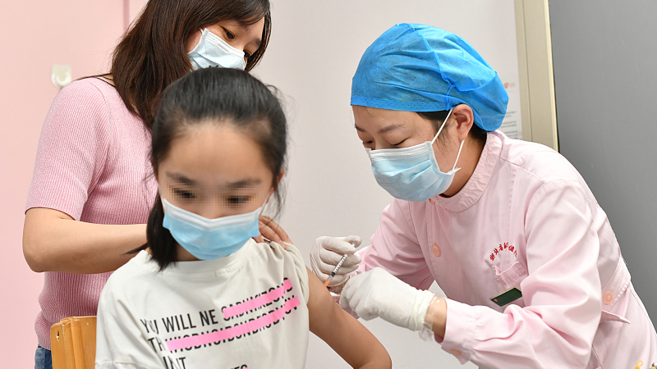
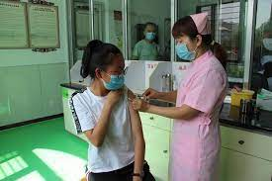
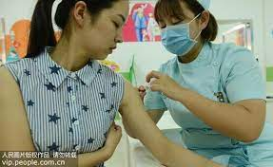
Target girl for HPV routine and Multi-Age Cohort Campaign
Target population for HPV vaccination for routine will be the 9 years old girl
Target population for HPV vaccination for MAC (Multi-Age Cohort Campaign) will be from 10 to under 20 years old girl

Slide 4
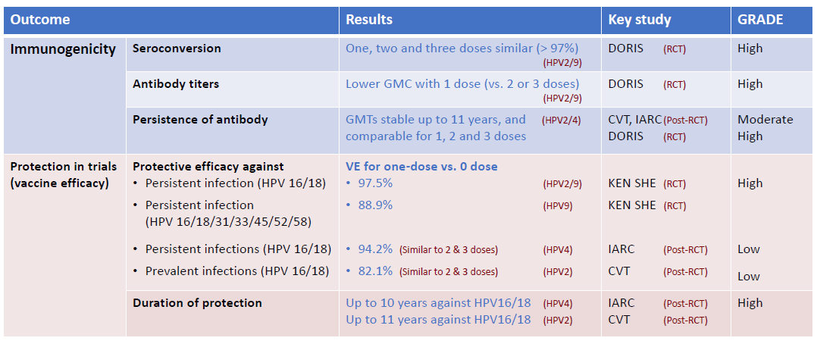
New evidences: Single dose schedule
New evidences: Single dose schedule
2. HPV vaccination schedule : Single dose schedule have been advised by WHO

Slide 5
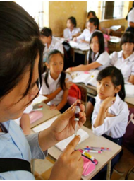
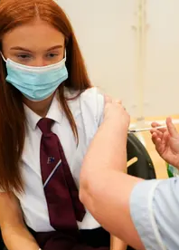
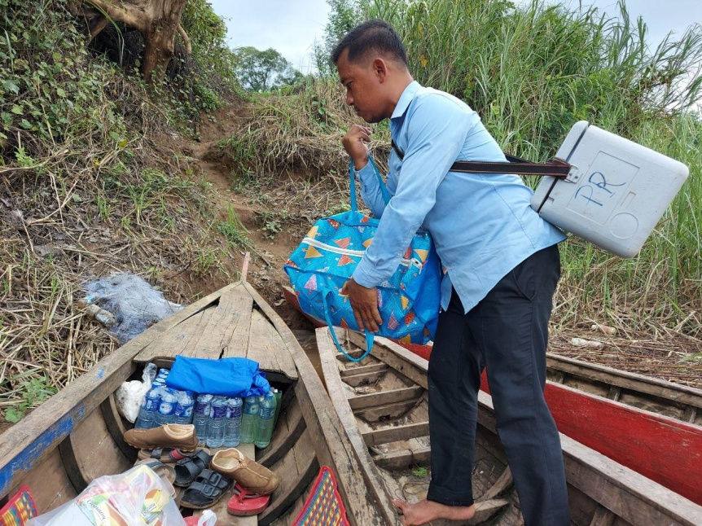
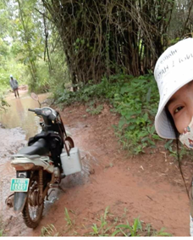
HPV vaccination strategy
HPV routine vaccination strategy
School vaccination (Primary school)
Fixed site facility and Outreach catch up vaccination for out of school girl
HPV MAC vaccination strategy
School vaccination (Primary, Secondary, High School and University)
Fixed site facility and Outreach catch up vaccination for out of school girl

Slide 6
Strengths and Challenges
Strengths:
Government of Cambodia encourage the Ministry of Health to introduce the HPV vaccine into routine immunization program
The HPV vaccine was highly demanded by community
Cambodia is still an eligible country for Gavi routine VIG from 2023
Challenges:
Supply constrain for HPV MAC
Cevarix will be available in 2026
Gardasil will be available in 2025
HPV MAC for 10-14 years old girl will be supported 100% for vaccine cost and 0.55$/girl for operational cost which will be need co-financing from government of Cambodia
HPV MAC for 15-20 years old girl will be paid by government of Cambodia

Slide 7
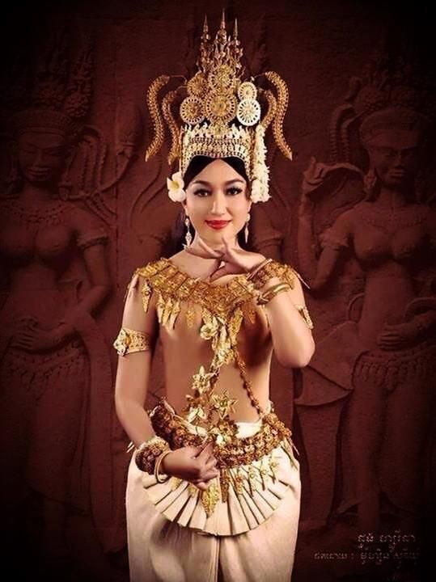
Thank you!

